Slide 1
Pharmacology
Anesthetics
ا.م.د.اسامة ايوب
فرع الادوية والسموم

Slide 2

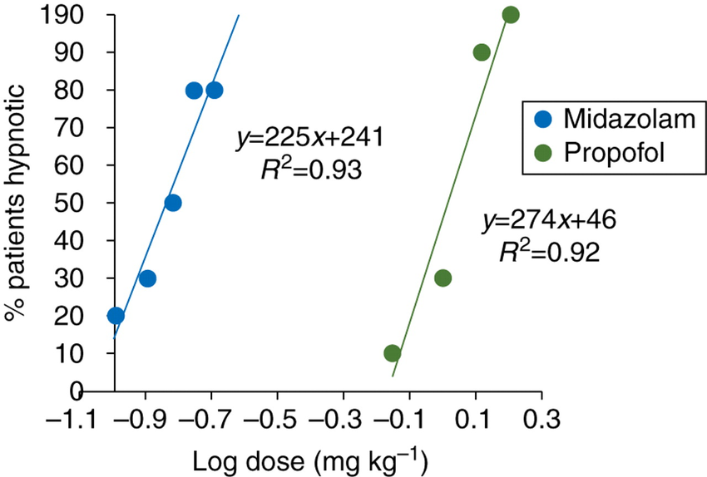
INHALATION ANESTHETICS
used primarily for the maintenance of anesthesia after administration of an IV agent
One advantage is that the depth of anesthesia can be rapidly altered by changing the inhaled concentration of the drug.
Inhalational general anesthetics have very steep dose-response curves.

Slide 3
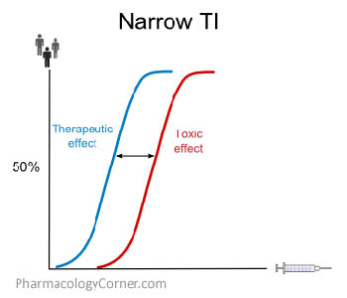
INHALATION ANESTHETICS
they have a very narrow therapeutic index (generally from 2 to 4),
To minimize waste and decrease cost, potent inhaled anesthetic agents are delivered in a recirculation system containing absorbents that remove carbon dioxide and allow re-breathing of the inhaled anesthetic.

Slide 4
Common features of inhalation anesthetics
nonflammable and nonexplosive
decrease cerebrovascular resistance, resulting in increased perfusion of the brain.
cause bronchodilation
The movement of these agents from the lungs to the different body compartments depends upon their solubility in blood and tissues as well as on blood flow

Slide 5
Potency
defined quantitatively as the minimum alveolar concentration (MAC).
which is the end-tidal concentration of inhaled anesthetic needed to eliminate movement in 50% of patients exposed to a noxious stimulus.MAC is the median effective dose (ED50) of the anesthetic expressed as the percentage of gas in a mixture required to achieve the effect.
(tidal volume)the normal volume of air displaced between normal inhalation and exhalation
MAC is small for potent anesthetics, such as isoflurane, and large for less potent agents, such as nitrous oxide (N2O).
MAC values are useful in comparing pharmacologic effects of different anesthetics, The more lipid soluble lead to higher potency of the anesthetic.

Slide 6
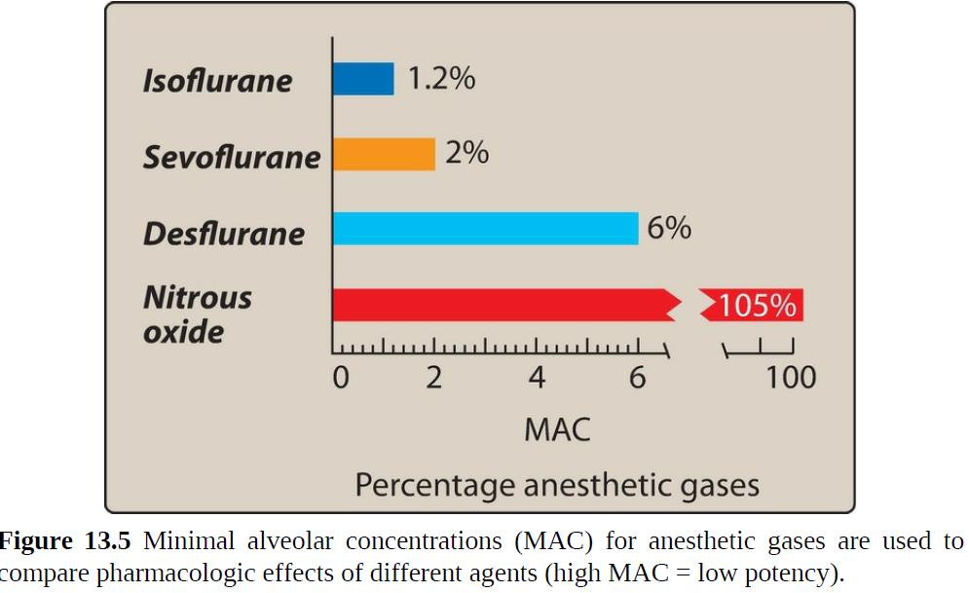

Slide 7
Potency
Factors that can increase MAC include
hyperthermia (greater than 42° C),
drugs that increase CNS catecholamines, and
chronic ethanol abuse.
Factors that can decrease MAC include
increased age, hypothermia, pregnancy, sepsis, acute ethanol intoxication, concurrent administration of IV anesthetics, and α2-adrenergic receptor agonists (such as clonidine and dexmedetomidine).

Slide 8
Uptake and distribution of inhalation anesthetics
The principal objective of inhalation anesthesia is to achieve a constant and optimal brain partial pressure (Pbr) of the inhaled anesthetic
alveoli are the "windows to the brain" for inhaled anesthetics.
The partial pressure of an anesthetic gas at the origin of the respiratory pathway is the driving force
gases move from one compartment to another within the body according to partial pressure gradients
a steady state is achieved when alveolar partial pressure = arterial partial pressure = brain partial pressure, or PA = Pa = Pbr.]
The time course for attaining this steady state

Slide 9
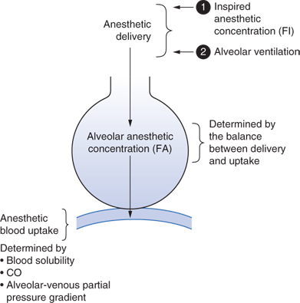
The time to reach steady state is determined by the following factors:
1-Alveolar wash-in:
This refers to the replacement of the normal lung gases with the inspired anesthetic mixture.
it is directly proportional to the functional residual capacity of the lung (the volume of gas remaining in the lungs at the end of a normal expiration)
inversely proportional to the
ventilator rate.
2. Anesthetic uptake:product of
gas solubility in the blood,
cardiac output, and
the anesthetic gradient between alveolar and blood partial pressure gradients.

Slide 10
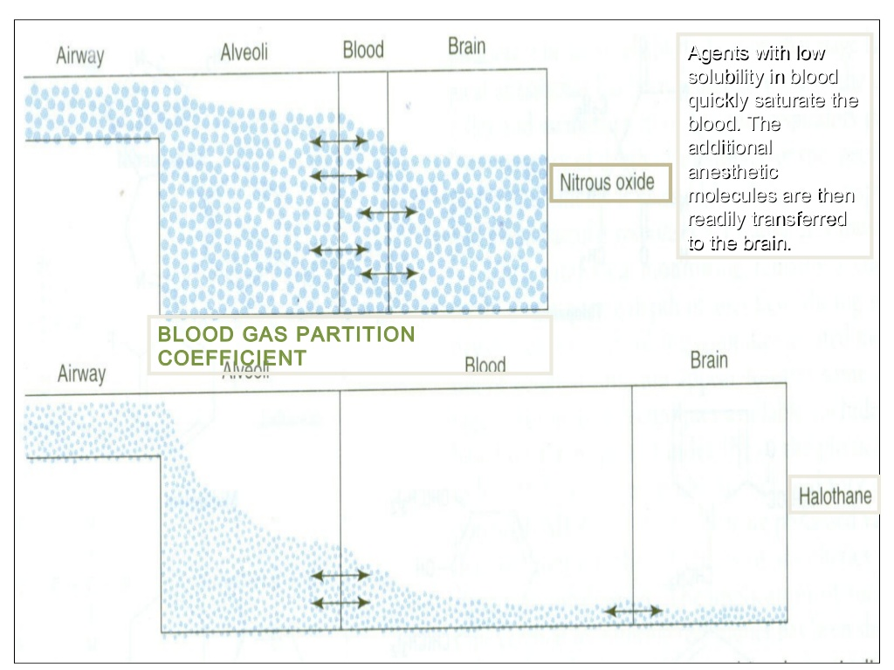
a. Solubility in the blood:
Drugs with low versus high solubility in blood differ in their speed of induction of anesthesia.
For example, when an anesthetic gas with low blood solubility, such as nitrous oxide, diffuses from the alveoli into the circulation, little of the anesthetic dissolves in the blood. Therefore, the equilibrium occurs rapidly, thus, quickly saturate the blood.
In contrast, high blood solubility, such as isoflurane, longer periods of time are required to raise blood partial pressure.

Slide 11
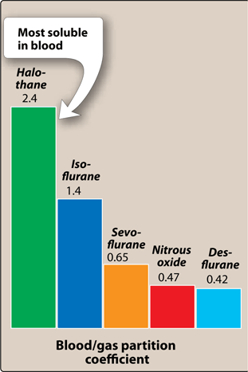
a. Solubility in the blood:
physical property of the anesthetic determine blood/gas partition coefficient,
Think of the blood as a pharmacologically inactive reservoir.
increased times of induction and recovery and slower changes in the depth of anesthesia in response to alterations in the concentration of the inhaled drug.
The solubility in blood is ranked in the following order:

Slide 12
b.Cardiac output :
higher CO removes anesthetic from the alveoli faster (because of increased blood flow through the lungs) and thus slows the rate of rise in the alveolar concentration of the gas.
inhaled anesthetics, higher CO = slower induction.
A low CO (shock) speeds the rate of rise of the alveolar concentration of the gas, since there is less uptake (removal to peripheral tissues) to oppose input.
Although a high CO will quickly transport the drug to the brain, a lower concentration of the drug with a shorter exposure time slows down the rate of induction.
c. Alveolar to venous partial pressure gradient of the anesthetic:
The greater is the difference in anesthetic concentration between alveolar (arterial) to venous blood, the higher the uptake and the slower the induction.
Over time, the partial pressure in the venous blood closely approximates the partial pressure in the inspired mixture.
That is, no further net anesthetic uptake from the lung occurs.

Slide 13
3. Effect of different tissue types on anesthetic uptake:
The time required for a particular tissue to achieve a steady state with the partial pressure of an anesthetic gas in the inspired mixture is
inversely proportional to the blood flow to that tissue
directly proportional to the capacity of that tissue to store anesthetic
Capacity, in turn, is directly proportional to the tissue’s volume and the tissue/blood solubility coefficient of the anesthetic molecules.

Slide 14
Four major tissue compartments determine the time course of anesthetic uptake:
Brain, heart, liver, kidney, and endocrine glands: These highly perfused tissues rapidly attain a steady state
Skeletal muscles: These are poorly perfused during anesthesia. This, and the fact that they have a large volume, prolongs the time required to achieve steady state.
Fat: This tissue is also poorly perfused. However, potent volatile general anesthetics are very lipid soluble. Therefore, fat has a large capacity to store anesthetic. This combination of slow delivery to a high-capacity compartment prolongs the time required to achieve steady state in that tissue.
Bone, ligaments, and cartilage: These are poorly perfused and have a relatively low capacity to store anesthetic. Therefore, these tissues have only a slight impact on the time course of anesthetic distribution in the body.

Slide 15
Washout
When an inhalation anesthetic gas is removed from the inspired admixture, the body becomes the repository of anesthetic gas to be circulated back to the alveolar compartment. Thus, nitrous oxide exits the body faster than does isoflurane

Slide 16
Mechanism of action
An interactions of the inhaled anesthetics with proteins comprising ion channels occurred:
Increase the sensitivity of the γ-aminobutyric acid (GABAA) receptors to the inhibitory neurotransmitter GABA.

Slide 17
Mechanism of action
2-nitrous oxide and ketamine do not have actions on GABAA receptors. Their effects are mediated via inhibition of N-methyl-D-aspartate (NMDA) receptorsexcitability and, thus, CNS activity are diminished
3-The activity of the inhibitory glycine receptors in the spinal motor neurons is increased.
4-The inhalation anesthetics block the excitatory postsynaptic current of the nicotinic receptors.

Slide 18
Isoflurane
undergoes little metabolism and is not toxic to the liver or kidney.
Isoflurane does not induce cardiac arrhythmias and does not sensitize the heart to the action of catecholamines.
However, it produces dose-dependent hypotension due to peripheral vasodilation.
With a higher blood solubility takes longer to reach equilibrium, making it less ideal for short procedures;
its low cost makes it a good option for longer surgeries.

Slide 19
Desflurane
provides very rapid onset and recovery due to its low blood solubility.
it a popular anesthetic for short procedures.
It has a low volatility, which requires administration via a special heated vaporizer.
it decreases vascular resistance and perfuses all major tissues very well.
Has significant respiratory irritation like isoflurane so it should not be used for inhalation induction.
Its degradation is minimal and tissue toxicity is rare.
Higher cost occasionally prohibits its use.

Slide 20
Sevoflurane
has low pungency or respiratory irritation.
This makes it useful for inhalation induction, especially with pediatric patients who do not tolerate IV placement.
It has a rapid onset and recovery due to low blood solubility.
Sevoflurane has low hepatotoxic potential and compounds formed in the anesthesia circuit may be nephrotoxic

Slide 21
Nitrous oxide
Nitrous oxide (“laughing gas”), is non-irritating and a potent sedative but a weak general anesthetic even at 80%.
nitrous oxide is frequently employed at concentrations of 30–50 % combination with oxygen for sedation, particularly in dental surgery.
.
Nitrous oxide does not depress respiration, and maintains cardiovascular hemodynamics as well as muscular strength.

Slide 22
Malignant hyperthermia
In a very small percentage of susceptible patients, exposure to halogenated hydrocarbon anesthetics (or succinylcholine)
Uncontrolled increase in skeletal muscle oxidative metabolism, overwhelming the body’s capacity to supply oxygen, remove carbon dioxide, and regulate temperature, eventually leading to circulatory collapse and death if not treated immediately.
MH is due to an excitation–contraction coupling defect
Burn victims and individuals with muscular dystrophy, myopathy, myotonia, and osteogenesis imperfecta are susceptible
Dantrolene is given as the anesthetic mixture is withdrawn, and measures are taken to rapidly cool the patient.
Dantrolene blocks release of Ca2+ from the sarcoplasmic reticulum of muscle cells, reducing heat production and relaxing muscle tone.

